Slide 1

Introduction to DBMS

Slide 2
Agenda
Introduction to DBMS and RDBMS
Key attributes
Introduction to SQL
Data Types
SQL Commands
DDL
- DML
- DQL
- Select Statements

Slide 3
What is DBMS?
DBMS stand for Database Management Systems
These are systems to store, retrieve or ,sometimes, manipulate data
Developed to handle large amount of data

Slide 4
Why DBMS?
Consider a bank that maintains customer’s account details, employee details, bank device details, etc.
This details needs to be stored in such a way that it can be added, deleted, updated and retrieved from one place
DBMS is a software designed for this type of operations

Slide 5
RDBMS

Slide 6
What is RDBMS?
RDBMS stand for Relational Database Management Systems
RDBMS allows to store, retrieve or manipulate data, but in a more efficient way than DBMS
Apart from rows and columns the RDBMS table has following components
Domain
Instance
Schema
Keys

Slide 7
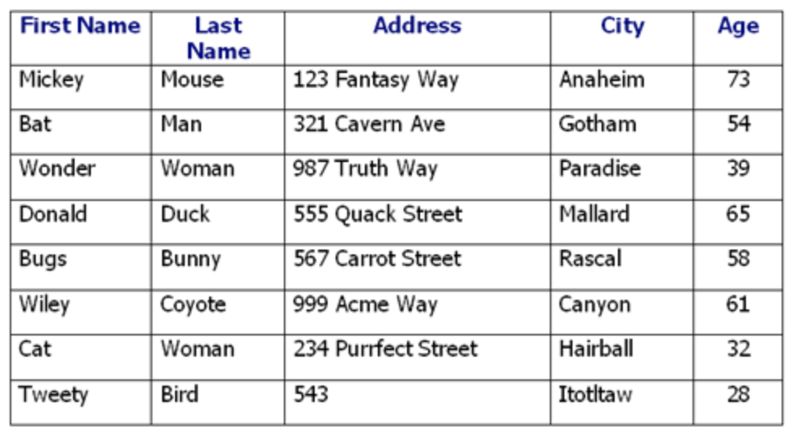
A database table
A database consists of one or more tables
A table is the most significant component in an RDBMS
A table is where all data is stored
A table constitutes of rows & columns
Each column represents attributes of the entity

Slide 8
A record in a table
Each row in a table is a record/tuple
Each record is all of the information for each object, say a person or a product

Slide 9
A column in a table
Each column in a table is an attribute
This gives one piece of information about the attribute. For example, last name of a customer

Slide 10
Keys
A key is a data item (a column or a set of column) to uniquely identify a record in a table
It is used to fetch a single or a set of records from a table
Keys can also provide several types of useful constraints. For example, a unique key constraint can help avoid enter a duplicate value

Slide 11
Keys
A database supports various types of keys. Some of them are
Candidate key
Primary key
Foreign key
Unique key
Alternate key

Slide 12
Keys
Candidate key: An attribute (column) of a set of attributes that uniquely identifies a record
eg.: Customer ID + Store ID + Location ID in a customer transaction table
Primary key: Identifies each record in a table and must never be the same for 2 records in a table
eg..: Customer ID identifying a customer uniquely in a customer table

Slide 13
Difference between Candidate Key and Primary Key
Candidate Key | Primary Key
Candidate Key can be any column or a combination of columns that can qualify as unique key in database | A Primary Key is a column or a combination of columns that uniquely identify a record
There can be multiple Candidate Keys in one table. Each Candidate Key can qualify as Primary Key. | There is only one Primary Key in a table

Slide 14
Keys
Foreign key: Foreign keys are the columns of a table that points to the primary key of another table
eg.: CustomerID in customer transaction table points to the CustomerID in the customer tables

Slide 15
Keys
Alternate key: An alternate key is a candidate key that is not considered as a primary key
eg.: Store Name + Store Location in a store information table
Unique key: An attribute or a set of attributes to uniquely identify a record in a table. This is similar to a primary key but can contain a null value.
eg.: Store Name in a store information table

Slide 16
Domain
A domain is a set of values that an attribute can take
An attribute would not accept any value outside of its domain
For example, in a bank customer table, the field “account_no” will only accept integer values if you give the domain of the field as integer
Apart from data type, you can set constraints to the attributes as well
Such combination of constraints are known as Domain Constraints

Slide 17
Schemas
A database schema is a blueprint that represents the logical view of the database
It defines tables and the relationship between them
A database schema is broadly categorized into
Physical Schema: How data is stored in actual storage is described at this level
Logical Schema: Pertains to the logical constraints (design) that need to be applied to the data stored

Slide 18
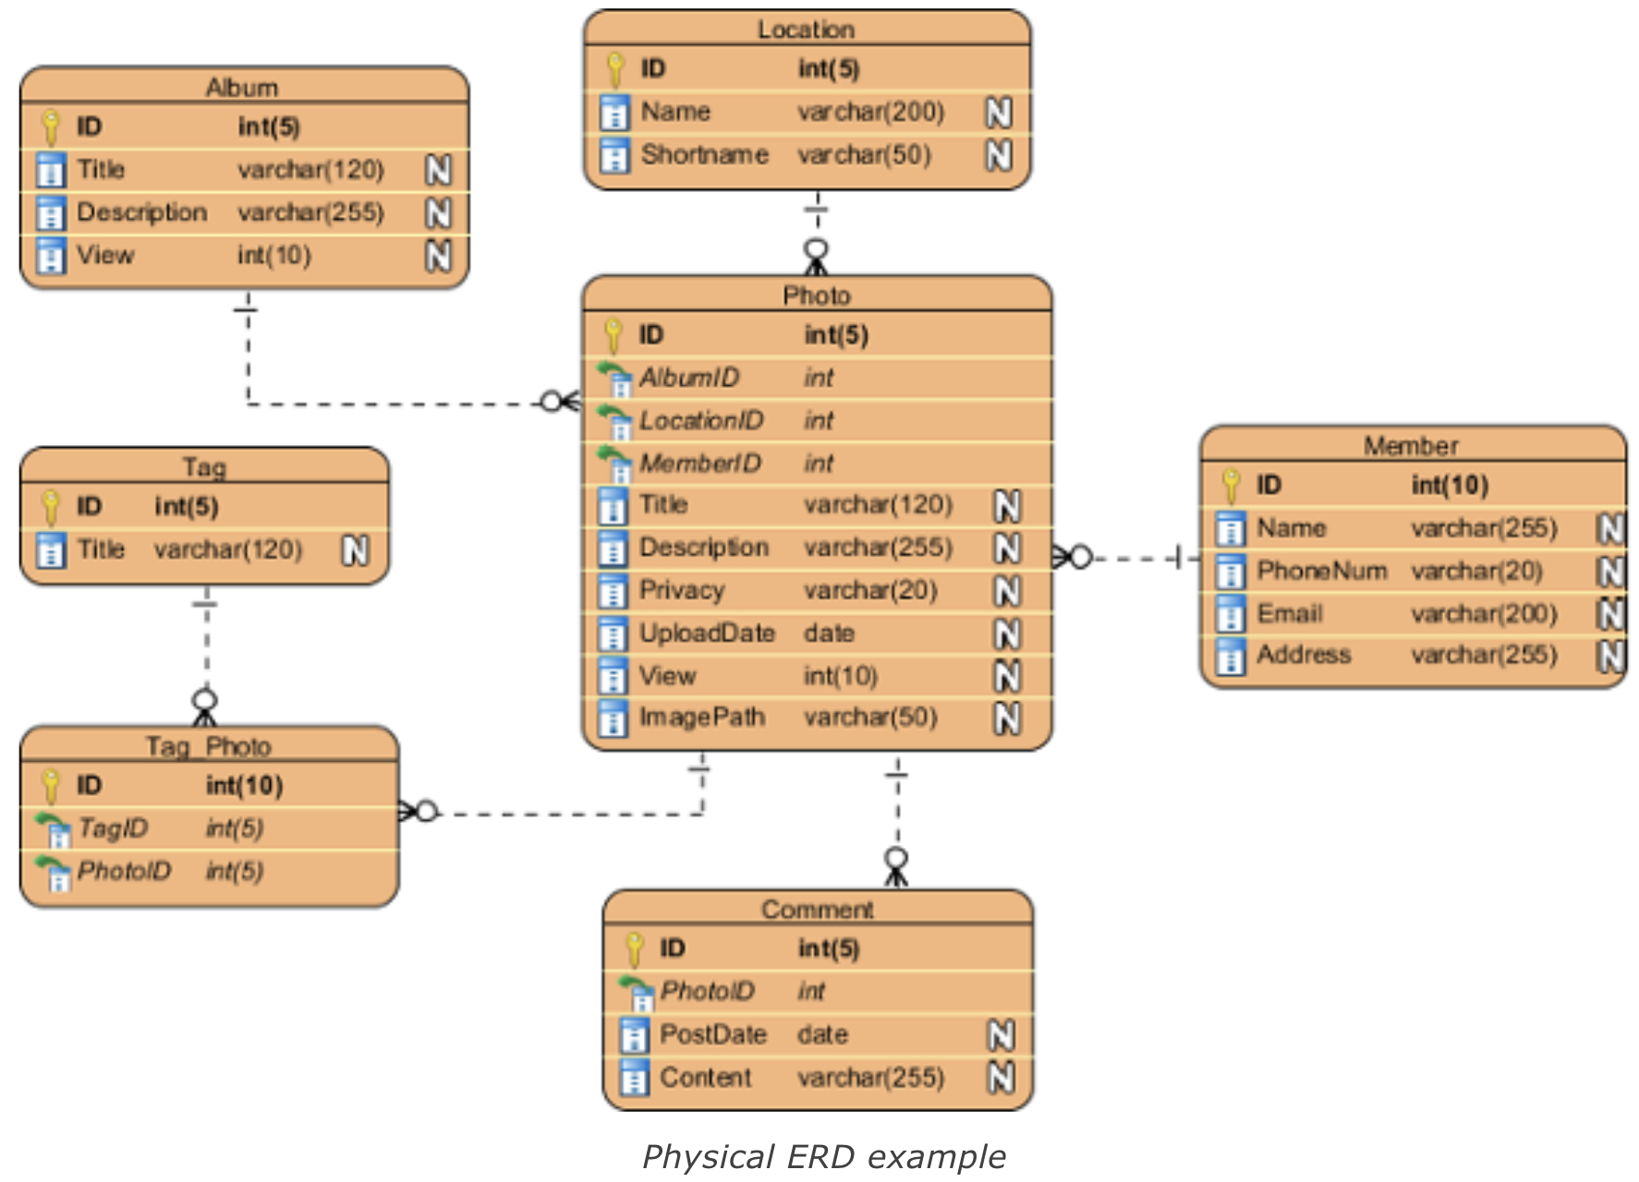
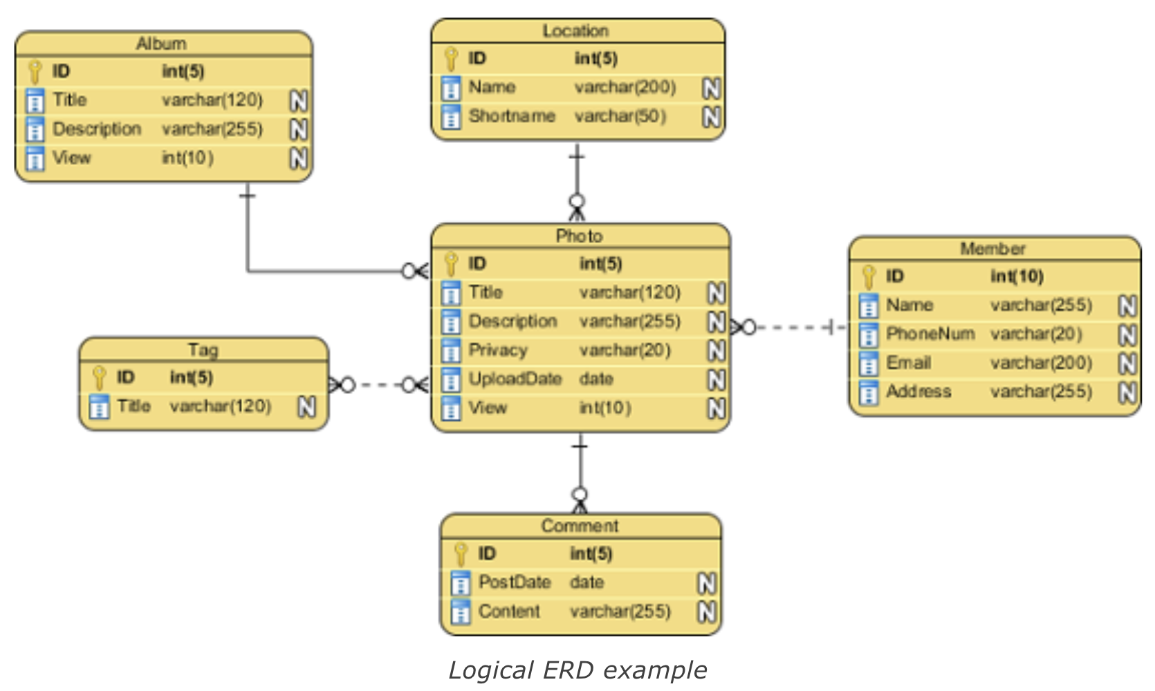
Logical vs Physical Schemas
Logical schema is designed based on information gathered from business requirements. This schema need not have any column types defined. But in case you do so it is with the intent to help in business analysis
Physical schema represents actual blueprint of a relational database. In this schema, the data types, primary key, foreign keys and constraints are to be designed by the database designers.

Slide 19
Instance
In RDBMS, there are lot of changes taking place in a table, over time
Data get inserted, manipulated and deleted in parallel
The data stored in a database at a particular moment of time is called instance

Slide 20
Instance
For example, consider ‘customer’ table in the database ‘bank’ has 10,000 records, so the instance of the database at this point is 10,000
Let’s say, we are going to add 1000 more records in the same table, tomorrow
So the instance of the database will be 11,000 tomorrow

Slide 21

There are many benefits to having a DBMS, but one of the most important is the security it provides to your business or organization.
Using a database management system lets end users and programmers access the same data without compromising its integrity.

Slide 22
Structured Query Language (SQL) Basics

Slide 23
SQL Introduction
The commands available in SQL can be broadly categorised as follows:
Data Definition Language (DDL)
Data Manipulation Language(DML)
Data Query Language (DQL)
Data Control Language (DCL)
Transactional Control Language (TCL)

Slide 24
Types of SQL Commands
SQL Commands
DDL
Data Definition Language
DML
Data Manipulation Language
DQL
Data Query Language
DCL
Data Control Language
TCL
Transactional Control Language
Create
Insert
Select
Grant
Commit
Roll Back
Alter
Update
Revoke
Save point
Drop
Delete
Set Transaction
Truncate

Slide 25

Types of SQL Commands
SQL Commands
DDL
Data Definition Language
DML
Data Manipulation Language
DQL
Data Query Language
DCL
Data Control Language
TCL
Transactional Control Language
Create
Insert
Select
Grant
Commit
Roll Back
Alter
Update
Revoke
Save point
Drop
Delete
Set Transaction
Truncate

Slide 26
Data Definition Language (DDL)

Slide 27
Data Definition Language (DDL)
A database is a collection of many tables, and a database server can hold many of these databases
Database Server —> Databases —> Tables (defined by columns) —> Rows
Databases and tables are referred to as database objects
Any operation, such as creating, modifying, or deleting database objects, is called Data Definition Language (DDL)

Slide 28
Data Definition Language (DDL)
DDL is used to create a new schema as well as to modify an existing schema
The typical commands available in DDL are:
CREATE
ALTER
DROP
TRUNCATE

Slide 29
Create Database

Slide 30
DDL - CREATE DATABASE- Syntax
The CREATE DATABASE statement is used to create a new SQL database
Syntax:
CREATE DATABASE databasename;
The semicolon character (;) is a SQL statement terminator
To create tables in the database you need to first select the database. Use the following syntax to select the database:
USE databasename;

Slide 31
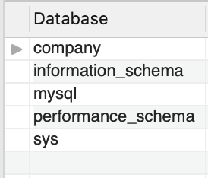
DDL - CREATE DATABASE - Example
We will create a database called company
CREATE DATABASE company;
Use SHOW DATABASES to check if the database company has been CREATED
The database company is now created
Default system databases

Slide 32
Drop Database

Slide 33
DDL - DROP DATABASE - Syntax
The DROP DATABASE statement is used to drop an existing SQL database
Syntax:
DROP DATABASE databasename;
Database name

Slide 34
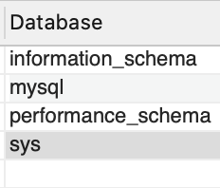
DDL - DROP DATABASE - Example
The following SQL statement drops the existing database "company":
DROP DATABASE company;
Use SHOW DATABASES to check if the database company has been DROPPED
We see the database company is now dropped

Slide 35
Create Tables

Slide 36
Prerequisites for Creating Tables
To create and maintain table, you need a database
While defining columns in a table, you should mention:
the name of the columns,
datatype (integer, floating point, string, and so on), and
default value (if any)
Let’s take a look at data types before we create table

Slide 37
Data Types

Slide 38
Built - in Data Types
Numeric: TINYINT, SMALLINT, MEDIUMINT, INT, BIGINT, and BIT
Floating numbers: DECIMAL, FLOAT, and DOUBLE
Strings: CHAR, VARCHAR, BINARY, VARBINARY, BLOB, TEXT, ENUM, and SET
Date and Time: DATE, TIME, DATETIME, TIMESTAMP, and YEAR

Slide 39
Every relational database has its own maximum and minimum size limit for different data types, you don’t need to remember the limit. Idea is to have the knowledge of what data type to be used in a specific scenario

Slide 40
Numeric - Data Types
Datatype | From | To
Bit | 0 | 1
Tinyint | 0 | 255
Smallint | -32.768 | 32.767
mediumint | -8388608 | 8388607
int | -2,147,483,648 | 2,147,483,647
bigint | -9,223,372,036,854,775,808 | 9,223,372,036,854,775,807

Slide 41
Floating Numbers
Datatype | From | To
Decimal | -10^38 +1 | 10^38 -1
Float | -1.79E + 308 | 1.79E + 308

Slide 42
Strings
Datatype | Description
CHAR | Fixed length with maximum length of 8,000 characters
VARCHAR | Variable length storage with maximum length of 8,000 characters
BINARY | Fixed length with maximum length of 8,000 bytes
VARBINARY | Variable length storage with maximum length of 8,000 bytes
BLOB | For binary large objects
TEXT | Variable length storage with maximum size of 1GB data

Slide 43
Date and Time
Datatype | Description
DATE | Stores date in the format YYYY-MM-DD
TIME | Stores time in the format HH:MI:SS
DATETIME | Stores date and time information in the format YYYY-MM-DD HH:MI:SS
TIMESTAMP | Stores number of seconds passed since the Unix epoch (‘1970-01-01 00:00:00’ UTC)
YEAR | Stores year in 2 digit or 4 digit format. Range 1901 to 2155 in 4-digit format. Range 70 to 69, representing 1970 to 2069.

Slide 44

MySQL supports various data types. Refer to the MySQL documentation for more details (https://dev.mysql.com/doc/refman/8.0/en/data-types.html)

Slide 45
CREATE TABLE - Syntax
The CREATE TABLE statement is used to create a new table in a database
Syntax:
CREATE TABLE table_name (
column1 datatype,
column2 datatype,
column3 datatype,
....);
The column parameters specify the names of the columns of the table
The datatype parameter specifies the type of data the column can hold (e.g. varchar, integer, date, etc.).

Slide 46
CREATE TABLE - Example
We will create a customers table, which will hold the customers information
The table will have the following columns in it
CustomerID
FirstName
LastName and
Country

Slide 47
CREATE TABLE - Example
We will create a table “customers” in the company database. Select the database ‘company’ using USE company command
CREATE TABLE customers(
CustomerId int,
first_name varchar(20),
last_name varchar(20),
country varchar(20)
);
It is declared as an integer since it contains only integers
first_name, last_name, and country: They contain strings, so they are defined as varchar

Slide 48
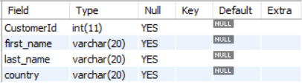
CREATE TABLE - Example
The CustomerID column is of type int and will hold an integer
‘firstName’, ‘lastName’, and ‘country’ columns are of type varchar with maximum length of 20 characters
Check the definition of the table by using: describe customers :

Slide 49
Drop Table

Slide 50
DROP TABLE - Syntax
The DROP TABLE statement is used to drop an existing table in a database
Syntax:
DROP TABLE table_name;

Slide 51
Be careful before dropping a table. Deleting a table will result in loss of complete information stored in the table!!!!

Slide 52
DROP and TRUNCATE TABLE - Example
The following SQL statement drops the existing table "company":
DROP TABLE customers;
The TRUNCATE TABLE statement is used to delete the data inside a table, but not the table itself
TRUNCATE TABLE customers;

Slide 53
Data Manipulation Language (DML)

Slide 54
Data Manipulation Language (DML)
As a data analyst, the majority of your work will focus on insight generation, and you will be working with DML commands
The typical commands available in DML are:
INSERT
UPDATE
DELETE
SELECT

Slide 55
INSERT

Slide 56
SQL INSERT - Syntax
The INSERT INTO statement is used to insert new records in a table
It is possible to write the INSERT INTO statement in two ways
The first way specifies both the column names and the values to be inserted
Syntax:
INSERT INTO table_name (column1, column2, column3, ...)
VALUES (value1, value2, value3, ...);

Slide 57
SQL INSERT - Syntax
Another way to insert values can be in the following manner where we do not use the column names:
Syntax:
INSERT INTO table_name VALUES (value1, value2, value3,...);
Make sure the order of the values is in the same order as the columns in the table

Slide 58
SQL INSERT - Example
Here we insert values into the customers table created earlier
The INSERT statement is used to create new records in a table
INSERT INTO customers (CustomerId,first_name,last_name,country)
VALUES
(1,'Mike', 'Christensen', 'USA'),
(2, 'Andy', 'Hollands', 'Australia'),
(3, 'Ravi', 'Vedantam', 'India');

Slide 59

INSERT - Example
The "customer" table will now look like this:

Slide 60
UPDATE

Slide 61
SQL UPDATE - Syntax
The UPDATE statement is used to modify the existing records in a table
Syntax:
UPDATE table_name
SET column1 = value1, column2 = value2, ...
WHERE condition;

Slide 62
Be careful when updating records in a table! Notice the WHERE clause in the UPDATE statement. The WHERE clause specifies which record(s) that should be updated. If you omit the WHERE clause, all records in the table will be updated!

Slide 63
SQL UPDATE - Example
We are updating the first row of the customers table
The first_name and the last_name will be updated to John, Kent from the country ‘USA’
UPDATE customers
SET first_name = 'John', last_name= 'Kent'
WHERE country = 'USA';

Slide 64

UPDATE - Example
The "customer" table will now look like this:

Slide 65
DELETE

Slide 66
SQL DELETE - Syntax
The DELETE statement is used to delete existing records in a table
Syntax:
DELETE FROM table_name WHERE condition;

Slide 67
Be careful when deleting records in a table! Notice the WHERE clause in the DELETE statement. The WHERE clause specifies which record(s) should be deleted. If you omit the WHERE clause, all records in the table will be deleted!

Slide 68

SQL DELETE - Example
We are deleting the first row where, first name is John
DELETE FROM customers WHERE first_name='John';
The "customer" table will now look like this:

Slide 69
Data Query Language (DQL)

Slide 70
SELECT Statement - Syntax
The SELECT statement is used to retrieve data from a table
The data returned is stored in a result table, called the result-set
Syntax:
SELECT column1, column2, … FROM table_name;

Slide 71
SELECT Statement - Syntax
column1, column2, ... are the field names of the table you want to select data from
If you want to select all the fields available in the table, use the following syntax
SELECT * FROM table_name;

Slide 72
SELECT Statement - Data
Below is a selection from the "Customers" table in the “company” database:
CustomerID | FirstName | LastName | country
1 | Mike | Christensen | USA
2 | Andy | Hollands | Australia
3 | Rahul | Vedantam | India
4 | Jeevan | Sharma | India

Slide 73
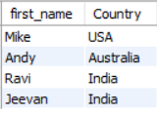
SELECT Column - Example
The following SQL statement selects the "first_name"and “country”columns from the "Customers" table:
SELECT first_name, Country FROM Customers;
Output:

Slide 74
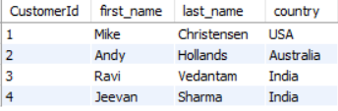
Selecting all columns - Example
The following SQL statement selects all the columns from the "Customers" table:
SELECT * FROM Customers;
Output:

Slide 75
WHERE Clause- Syntax
The WHERE clause is used to filter records
The WHERE clause is used to extract only those records that fulfill a specified condition
Syntax:
SELECT column1, column2, … FROM table_name WHERE condition;

Slide 76
The WHERE clause is not only used in SELECT statement, it is also used in UPDATE, DELETE statement, etc.!

Slide 77

WHERE Clause- Example
The following SQL statement selects all the customers from the country "India", in the "Customers" table:
SELECT * FROM Customers WHERE Country='India';
Output:

Slide 78
Operators in the WHERE Clause
The following operators can be used in WHERE clause
Operator | Description
= | Equal
> | Greater than
< | Less than
>= | Greater than or equal
<= | Less than or equal

Slide 79
Operators in the WHERE Clause
Operator | Description
<> | Not equal. In some versions of SQL the operator may be written as !=
BETWEEN | Between a certain range
LIKE | Search for a pattern
IN | To specify multiple possible values for a column

Slide 80
By default, The SQL Keywords are case-insensitive (SELECT, FROM, WHERE, AS, etc.) but are usually written in all capitals. However, MySQL has a configuration option to enable or disable it

Slide 81
Compound Search Conditions

Slide 82
Compound Search Conditions
The compound conditions are made up of multiple simple conditions connected by AND or OR
There is no limit to the number of simple conditions that can be present in a single query
They enable you to specify compound search conditions to fine tune your data retrieval requirements

Slide 83
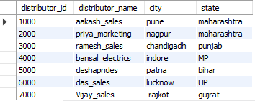
Compound Search Conditions
Use following table for further operations

Slide 84

Compound Search Conditions
Use of the "AND" and "OR" Conditions with the SELECT Statement
SELECT * FROM employeee.distributor
WHERE (state = 'maharashtra' AND distributor_id <> 7000)
OR (distributor_id = 1000);
Output:

Slide 85
Explanation
Previous query will return all distributor that are in the state of Maharashtra but do not have a distributor_id equal to 7000
The query will also return distributor whose distributor_id is equal to 1000

Slide 86
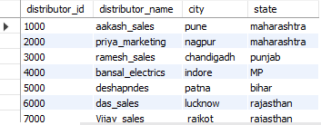
Compound Search Conditions
Use of AND and OR with UPDATE statement
UPDATE employeee.distributor SET state = 'rajasthan'
WHERE distributor_id = 6000 OR (distributor_id > 5000 AND city <> 'lucknow');
Output:

Slide 87
Missing Data

Slide 88
Checking Missing Data
The SQL NULL is the term used to represent a missing value
A NULL value in a table is a value in a field that appears to be blank.
You must use the IS NULL or IS NOT NULL operators to check for a NULL value

Slide 89
Checking Missing Data
Consider the following Employee table having the records as shown below
ID | NAME | AGE | ADDRESS | SALARY
1 | Kellie | 32 | California | 2000
2 | Pete | 25 | Texas | 1500
3 | Popy | 23 | Boston | 2000
4 | Sam | 25 | Florida
5 | Jhon | 27 | Hawaii

Slide 90
Is Not Null Operator
Syntax:
SELECT ID, NAME, AGE, ADDRESS, SALARY FROM Employee
WHERE SALARY IS NOT NULL;
Output:
ID | NAME | AGE | ADDRESS | SALARY
1 | Kellie | 32 | California | 2000
2 | Pete | 25 | Texas | 1500
3 | Popy | 23 | Boston | 2000

Slide 91
Is Null Operator
Syntax:
SELECT ID, NAME, AGE, ADDRESS, SALARY FROM Employee
WHERE SALARY IS NULL;
Output:
ID | NAME | AGE | ADDRESS | SALARY
4 | Sam | 25 | Florida
5 | Jhon | 27 | Hawaii

Slide 92
More Basic Operations - ALTER, DROP, RENAME

Slide 93
The Alter Query
Sometimes we need to incorporate changes to an already existing tables. For example, renaming a field, changing the data-type, etc
The alter command is used to make modification in an existing database/table
Alter command is generally used with clauses such as change, modify, add, drop

Slide 94
The Alter Query - Change Clause
To make changes in the column’s definition we use the Change clause
The change clause allows you to:
Change the name of the column
Change the column data type
Change column constraints
Syntax:
ALTER TABLE table_name CHANGE old_column_name new_column_name data type;

Slide 95
The Alter Query - Change Clause
Changing Column Definition
The ALTER TABLE command is used to specify the change in the structure of a table
This is followed by the CHANGE clause that tells the MySql server that we want to change the column name
The CHANGE clause is followed by an existing column name that needs to be changed
And finally, we mention the new definition (new name, new data type, new constraint(optional))

Slide 96
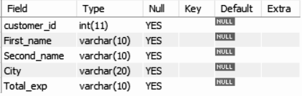
The Alter Query - Change Clause
Consider a table Customer with below fields
Here, we need to rename ‘Second_name’ as ‘last_name’ with increase in the number of characters

Slide 97
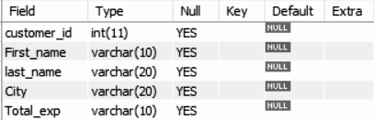
The Alter Query - Change Clause
Use below alter query to change the name of the field ‘Second_name’ to ‘last_name’
ALTER TABLE Customer CHANGE Second_name last_name varchar(20);
Use describe Customer to check if the column name has changed to the desired column name

Slide 98
The Alter Query - Modify Clause
The Modify clause allows you to:
Modify Column Data Type
Modify Column Constraints
Syntax:
ALTER TABLE table_name MODIFY current_column_name data type constraint;

Slide 99
Modify clause CANNOT be used to rename a column

Slide 100
The Alter Query - Change Clause
Modifying Column Definition
The ALTER TABLE command is used to specify the change in the structure of a table
This is followed by the MODIFY clause that tells the MySql server that we want to modify a column
The MODIFY clause is followed by an existing column name that needs to be changed
And finally, we mention the new definition of that column (new data type, new constraint(optional))

Slide 101
The Alter Query - Modify Clause
Consider a table Customer with below fields
Here, we need to increase the width of ‘First_name’ field from 10 to 25

Slide 102
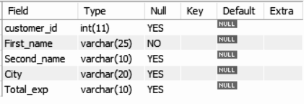
The Alter Query - Modify Clause
Use below alter query to change the width of ‘First_name’ to varchar(25) with a NOT NULL constraint
ALTER TABLE Customer MODIFY First_name varchar(25) NOT NULL;
Use describe Customer to check if the column name has changed to the desired column name

Slide 103
Difference between Change and Modify Clause
If you have already created your MySQL database, and decide after the fact that one of your columns is named incorrectly, you can simply rename it using CHANGE
MODIFY does everything CHANGE can, but without renaming the column

Slide 104
The Alter Query - Add Clause
The Add clause allows you to:
Add a new column to an existing table
Add primary key constraint to an existing column

Slide 105
The Alter Query - Add Clause
Adding a new column to a table
To add a new column to an existing table, we use the ADD COLUMN clause with the ALTER command in the following way
Syntax:
ALTER TABLE table_name ADD COLUMN column_name

Slide 106
The Alter Query - Add Clause
Consider the previously created table Customer:
Here, we add a new column ‘Salary’ to this table

Slide 107
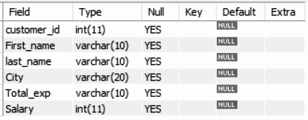
The Alter Query - Add Clause
Use below alter query with the add clause:
ALTER TABLE Customer ADD COLUMN Salary int;
Use describe Customer to check if a new column has been added to the table

Slide 108
By default, the ADD clause adds a column at the end of the table. Use the AFTER keyword to add a column at a particular position in a table
For example: To add a ‘Date_of_Birth’ column after ‘last_name’ column in the table Customer, use the following query :
ALTER TABLE Customer ADD Date_of_Birth date AFTER ‘last_name’;

Slide 109
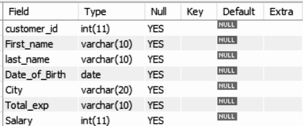
By default, the ADD clause adds a column at the end of the table. Use the AFTER keyword to add a column at a particular position in a table
Use describe Customer to check the table definition

Slide 110
The Alter Query - Drop Clause
Dropping a column from the table
Suppose you no longer need a column from a table for your analysis
In this scenario we use the ALTER command with the DROP clause to remove a column from the table
Syntax:
ALTER TABLE table_name DROP COLUMN column_name

Slide 111
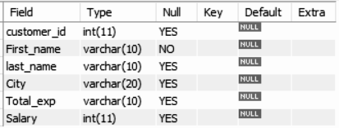
The Alter Query - Drop Clause
Consider a table Customer with below fields:
Here, we don’t need the column ‘Salary’ from the table

Slide 112
The Alter Query - Drop Clause
Use below alter query to drop the ‘Salary’ column from the table Customer
ALTER TABLE Customer DROP COLUMN Salary;
Use describe Customer to check if the column has been drop from the table

Slide 113
Revisiting The Drop Query
The DROP query allows you to:
Delete a database
Delete an existing table from the database
Syntax to delete an existing database:
DROP DATABASE database_name
Syntax to delete an existing table in a database:
DROP TABLE table_name

Slide 114
The Rename Query
The rename command is used to change the name of an existing database table to a new name
Renaming a table does not make it to lose any data is contained within it
Syntax:
RENAME TABLE current_table_name TO new_table_name

Slide 115

The Rename Query
Rename the current Customer table to Customer_info
You can use show tables command to retrieve the name of all the tables present in a database. ‘misc’ is the name of the database

Slide 116

The Rename Query
Below command changes the name of the table Customer to Customer_info:
RENAME TABLE Customer TO Customer_info
The name of the table Customer is now changed to customer_info:

Slide 117
Thank You

